Slide 1

OOP LAB 5 (18 Oct 22)
C# Object Oriented Programming
By: Miss Tia

Slide 2
C# Class and Object
In object-oriented programming (OOP), we solve complex problems by dividing them into objects. To work with objects, we need to perform the following activities:
create a class
create objects from the class
Example:
Class
Computer Science 1st Year
Object
Xing
Nadiah
Azhad
Ooi
Adriana
Methods
Talk
Sing
Sleep
Write code
Walk to class

Slide 3
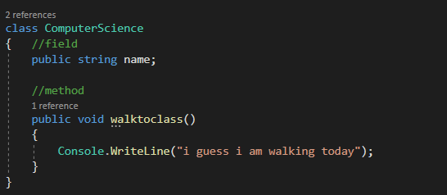
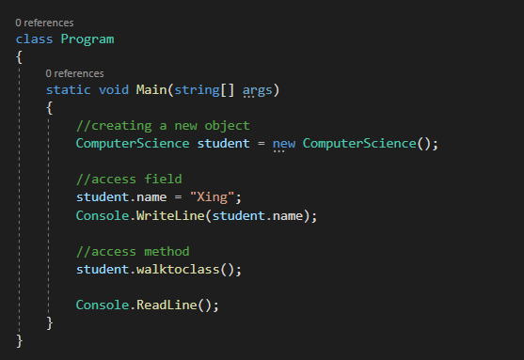
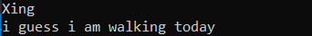
C# Class and Object
A Class is a "blueprint" for creating objects. We use the ‘class’ keyword to create an object. For example,
An object is created from a class. We have already created the class named ComputerScience, so now we can use this to create objects.
To create an object, specify the class name, followed by the object name, and use the keyword new

Slide 4
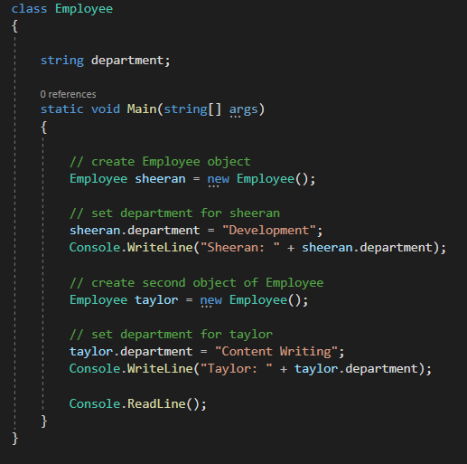
C# Class and Object
Objects and classes help us to divide a large project into smaller sub-problems.
Suppose you want to create a game that has hundreds of enemies and each of them has fields like health, ammo, and methods like shoot() and run().
With OOP we can create one Enemy class with required fields and methods. Then, we can create multiple enemy objects from it.
Each of the enemy objects will have its own version of health and ammo fields. And, they can use the common shoot() and run() methods.
Now, instead of thinking of projects in terms of variables and methods, we can think of them in terms of objects.
This helps to manage complexity as well as make our code reusable.

Slide 5
C# Methods
A method is a block of code that performs a specific task. Suppose you need to create a program to create a circle and color it. You can create two methods to solve this problem:
a method to draw the circle
a method to color the circle
returnType - It specifies what type of value a method returns. For example, if a method has an int return type then it returns an int value. If the method does not return a value, the return type is void.
methodName - It is an identifier that is used to refer to the particular method in a program.
method body - It includes the programming statements that are used to perform some tasks. The method body is enclosed inside the curly braces { }
returnType methodName() {
method body
}

Slide 6
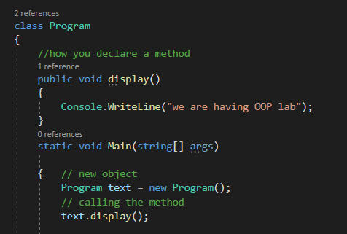
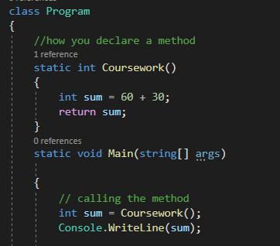
C# Methods
Here, the name of the method is display(). And, the return type is void.
Here, we are using the object ‘text’ to call the display() method.
If the method returns any value, we use the return statement to return any value.
One thing you should always remember is that the return type of the method and the returned value should be of the same type.
In our code, the return type is int. Hence, the data type of sum should be of int as well.
Output:

Slide 7
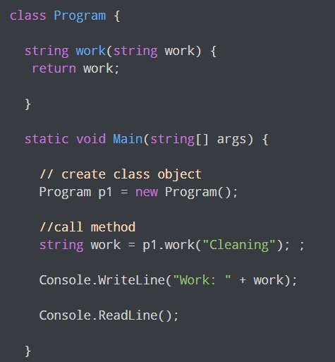
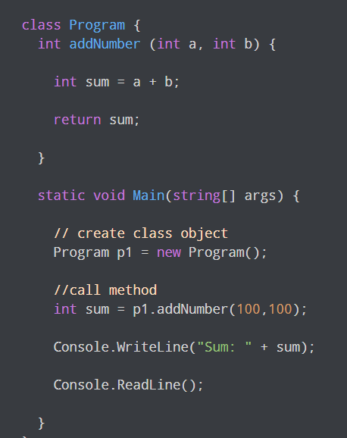
C# Methods Parameters
In C#, we can create a method with a single parameter. For example,
In C#, we can also create a method that accepts some value. These values are called method parameters. For example,
Here, a and b are two parameters passed to the
addNumber() function.
If a method is created with parameters, we need to pass the corresponding values(arguments) while calling the method. For example,

Slide 8
Let the debugging begins
​Exercise: Create a student class and object that gives your name, ID and the method you use to go to class.

Slide 9
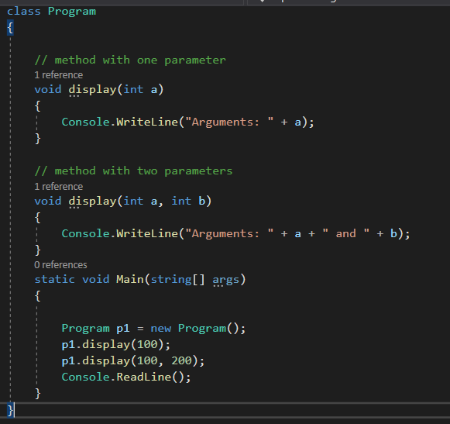

Method Overloading
In C#, we can create two or more methods with the same name. It is known as method overloading. For example,
Output:
In the example, we have overloaded the display() method. It is possible because with method overloading, multiple methods can have the same name with different parameters
one method has one parameter
another has two parameter

Slide 10
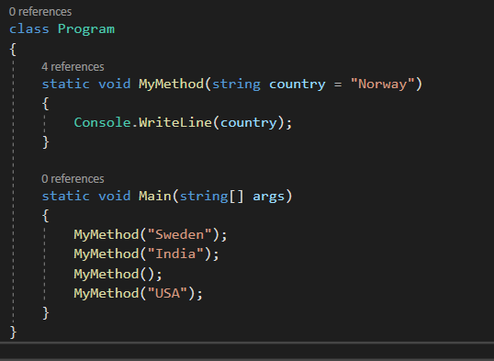

Method Default Parameter
You can also use a default parameter value, by using the equals sign (=).
If we call the method without an argument, it uses the default value ("Norway"):
Output:
A parameter with a default value, is often known as an "optional parameter".
From the example, country is an optional parameter and "Norway" is the default value.

Slide 11
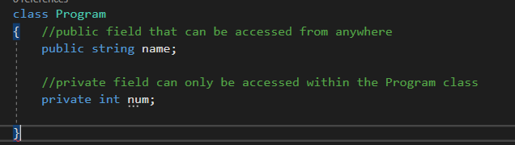
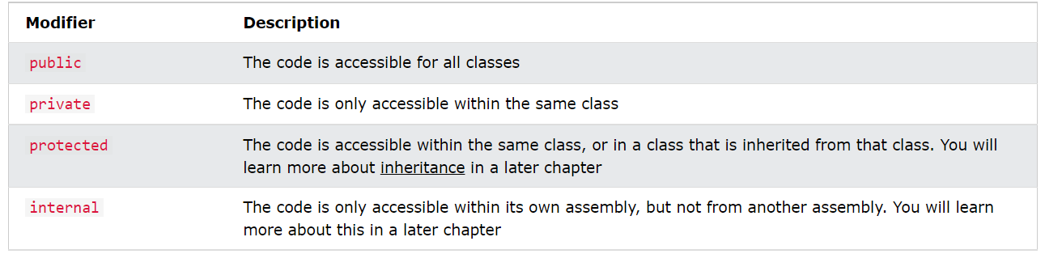
Access Modifier
In C#, access modifiers specify the accessibility of types (classes, interfaces, etc) and type members (fields, methods, etc). We will learn about the public, private, protected, and internal access modifiers in C#
In C#, there are 4 basic types of access modifiers.
public
private
protected
internal

Slide 12
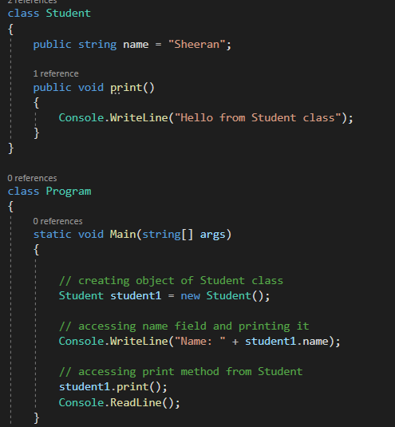
Public Access Modifier
In C#, there are 4 basic types of access modifiers.
public
private
protected
internal

Slide 13
Lab 5
​Exercise: debug every loop and decision
If statement
If else
Else if
For loop
While loop
Do while
Mix between loops

Slide 14
THANKS!

